Slide 1

House Prediction Project
Presented By – Naroj Santhosh Kumar

Slide 2
Topics:
Overview.
Problem Statement.
Problem Understanding.
Exploratory data analysis.
Visualizations.
Model Building.
Hyper Parameter Tunning.
Saving the model and predictions from saved best model.
Conclusion.

Slide 3
Overview:
In this particular presentation we will be looking on:
What are the EDA steps in cleaning the dataset.
Overall analysis on the problem.
Model building from train dataset.
Predicting Housing Price for test dataset.

Slide 4
Problem Statement
A US-based housing company named Surprise Housing has decided to enter the Australian market. The company uses data analytics to purchase houses at a price below their actual values and flip them at a higher price. For the same purpose, the company has collected a data set from the sale of houses in Australia. The data is provided in the CSV file below.
The company is looking at prospective properties to buy houses to enter the market. You are required to build a model using Machine Learning in order to predict the actual value of the prospective properties and decide whether to invest in them or not. For this company wants to know:
• Which variables are important to predict the price of variable?
• How do these variables describe the price of the house?

Slide 5
Problem Understanding
House price prediction can help the developer determine the selling price of a house and can help the customer to arrange the right time to purchase a house. House Price prediction, is important to drive Real Estate efficiency. As earlier, House prices were determined by calculating the acquiring and selling price in a locality. Therefore, the House Price prediction model is very essential in filling the information gap and improve Real Estate efficiency. The aim is to predict the efficient house pricing for real estate customers with respect to their budgets and priorities. By analysing previous market trends and price ranges, and also upcoming developments future prices will be predicted. ... cost of property depending on number of attributes considered. Now as a data scientist our work is to analyse the dataset and apply our skills towards predicting house price.

Slide 6
Data Analysics :
The Dataset Contains a Data of 1168 entries each having 81 variables, in which some are numerical Data and some are Categorical Data
As the Data having two datasets 1. Train Data, 2. Test Data
Check the info of the data using the info() function
From the above function I analyze the dataset having float varaibles -3 int-35 and object-43 so total of 81 variables.
Next Step is EDA……..(Exploratory Data Analysis)

Slide 7
Exploratory Data Analysis
In EDA we need to Pre-process the Data and Visualization:
Steps include in Pre-Processing Data are
Data Cleaning:
Removing Outliers, Skewness and imputing Missing Values.
Data Transformation:
Like Normalization by applying normalization we can improve the accuracy and efficiency of the models. And also reduce the errors.
Data Reduction:
By Reducing the no of features by Feature Selection Process, PCA And VIF
Data Cleaning:
As a Part of EDA we need to do Data cleaning so firstly we need to check any null values in our data, From the below image shows we don’t have any null values, so no need to impute any data.

Slide 8
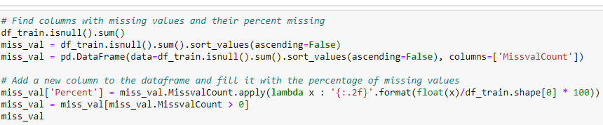
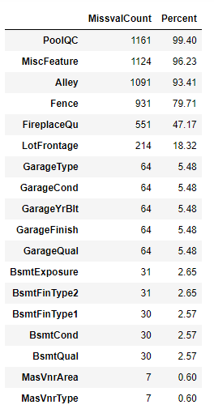
First Step of Data Cleaning is Checking Any null Values in our Data set For this we used the function
The Dataset Having the null values and removing the columns which is having the percentage more than 45%.
By comparing both train and test data column PoolQC, MiscFeature, Alley, Fence, FireplaceQu having more than 45% data is missing. Removing from data set and remaining all very small percent.
For the remaining missing values , we need to use the impute method.
For need to know how many unique values are there with the count by using this formula.

Slide 9
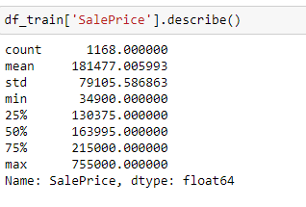
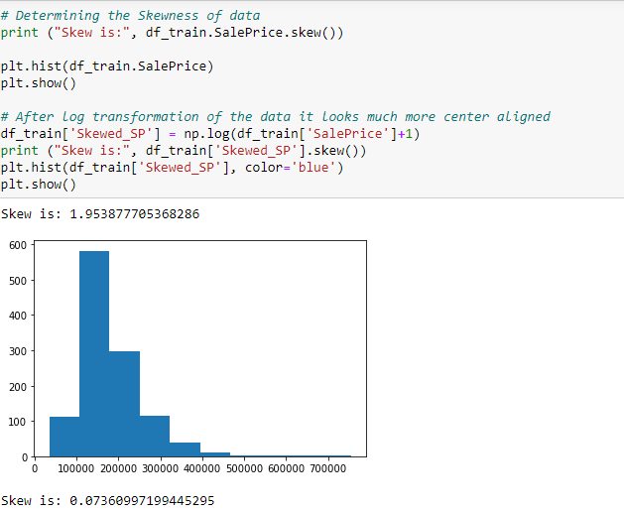
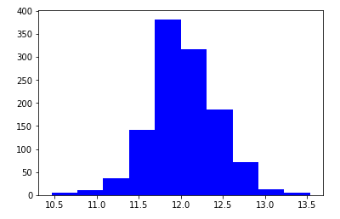
As it shows the 75% and Max having so much difference so our column is rightly skewed...so do skewing for plotting with variables

Slide 10
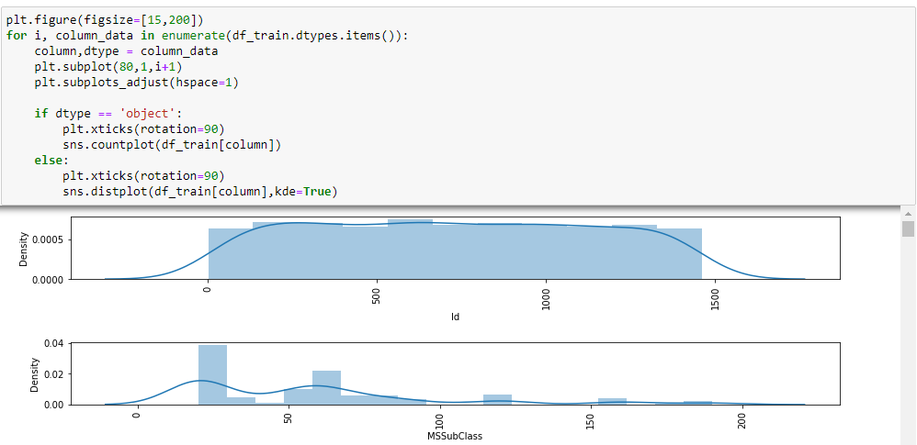
VISUALIZATION
We analyse the variables using “countplot” for categorical variables and “distplot” for numerical variables.

Slide 11
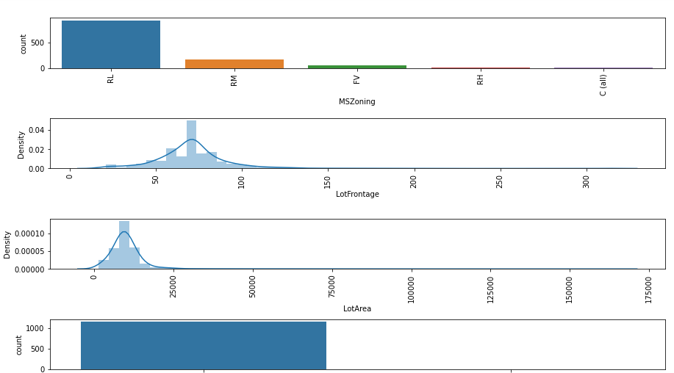
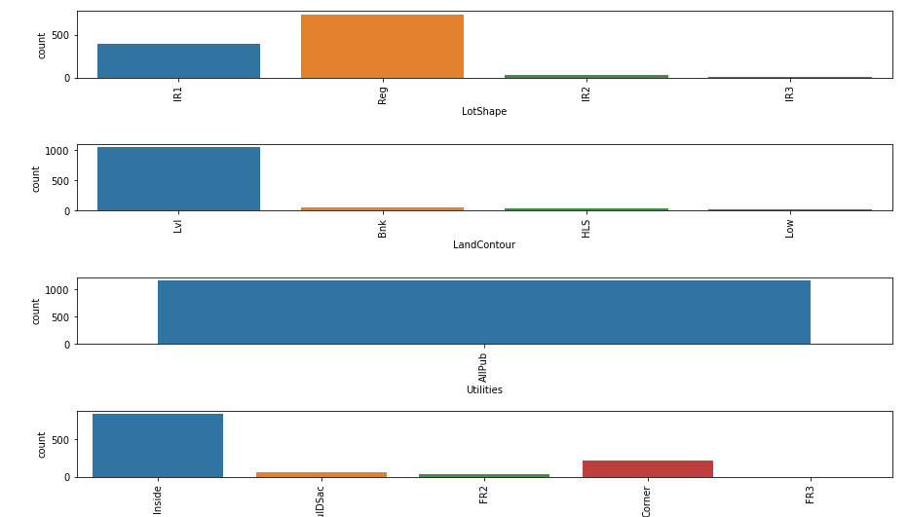
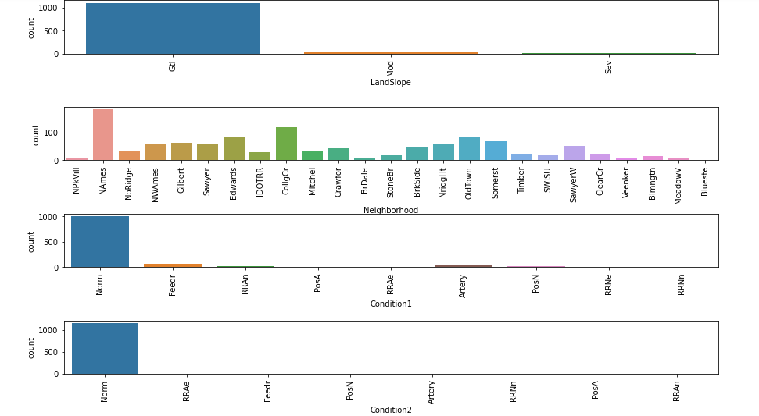
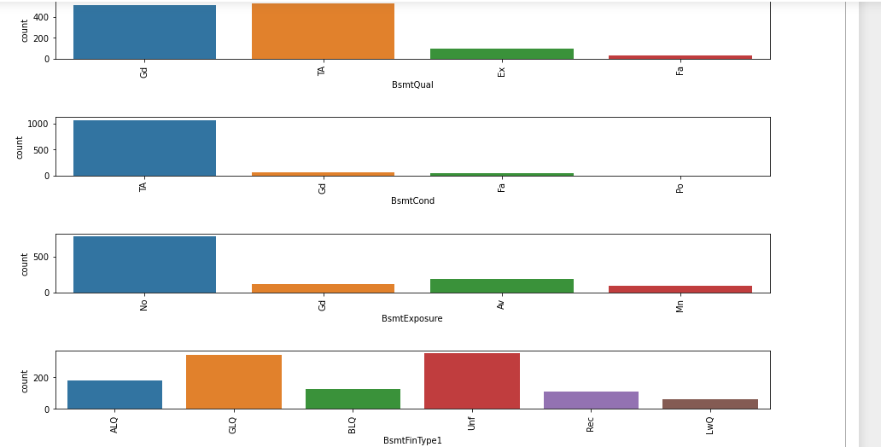
1.The Data mostly all numeric varaibles are skewed.
2.Sales Condition is Normal and sale type is Warranty DEED-Conventional.
3.Mostly are Paved Drive, Garage Conditions and Garage Quality are Typically/Average.
4.Mostly GarageFinish are unfinished and GarageType is Attached.
5.Mostly Home Functionality is Typical.
6.KitchenQuality is Typically Average.
7.Electrical is Standard Circuit Breakers & Romex.
8.Central Air is Yes.
9.Heating Quality COndition is Excellent.
10.Heating is Gas forced warm air furnished.
11.Basement Finish Type1 is Unfurnished.
12.Basement Finish Type2 is Unfurnished.
13.No Exposure to walkout or garden level walls.
14.VInylSD are mostly used material for rooms.

Slide 12
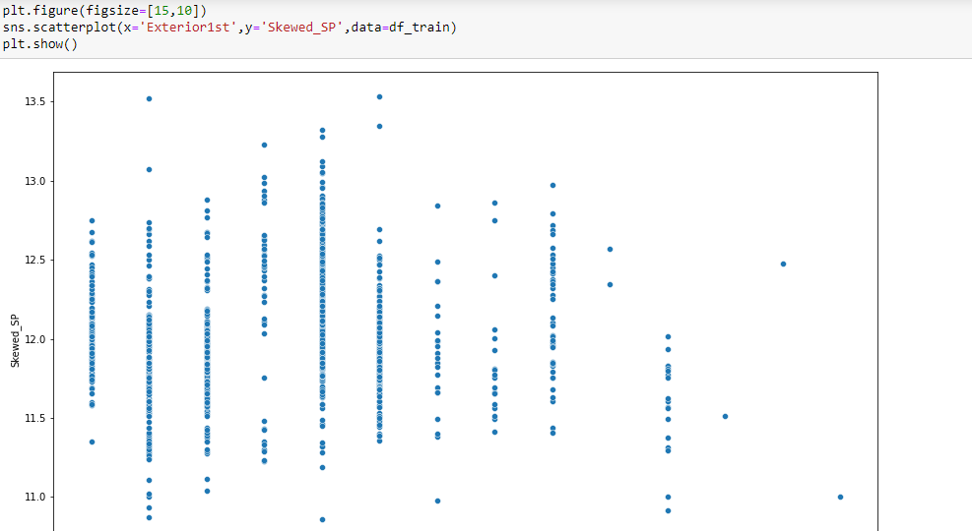
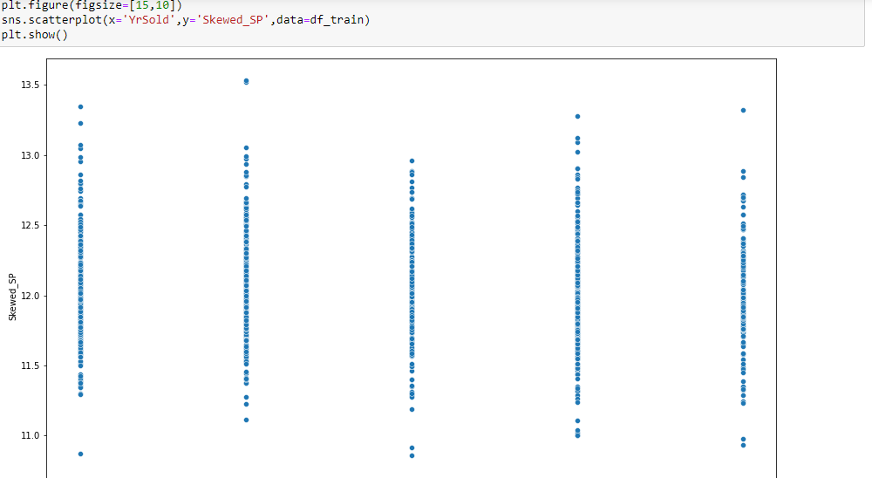
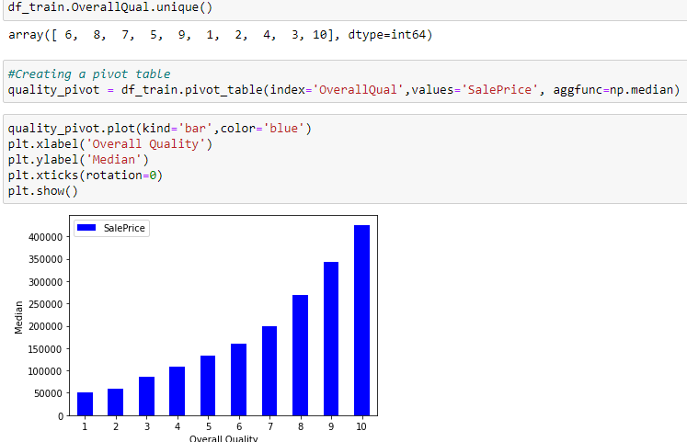

Slide 13
Skewness of Data:
As of our numeric data is skewed we need to do normalization before go for training and testing.
Than need to check the skewness of data, if our data is >0.5% in both +ve & -ve sides.
That means need to do power transformation and do scaling.
Scaling are of two types:
Standard Scaler: Standard scalar standardizes features of the data set by scaling to unit variance and removing the mean (optionally) using column summary statistics on the samples in the training data set.
MIN-MAX Scaler: For each value in a feature, MinMaxScaler subtracts the minimum value in the feature and then divides by the range. The range is difference between the original maximum and original minimum. MinMaxScaler preserves the shape of the original distribution.

Slide 14
MODELLING
We know that this is Regression problem. We have use R_2 score , MAE, MSE and RMSE as our evaluation matrix. We also need to see the cross validated score.
As we know, this data set has a lot of categorical features, before going for the modeling part first we have to change to features to data type.
We have do feature scaling to scaling the data.
First we see the result without doing hyper-parameter tuning.
We have to see several models as our evaluation model without using hyper-parameter tuning. See their result & after that we have to do hyper-parameter tuning . Compare both the result that which one gives better R_2 score.

Slide 15
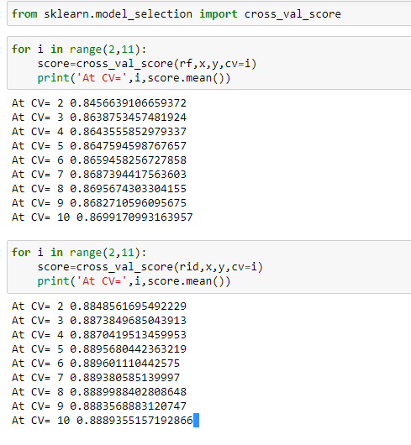
Cross Validation:
This technique is used to check whether out data set is over fitting or under fitting. If model score is high and cv score is less, it means model perform well in train dataset but did not perform well in unseen or test dataset. Feature selection is the best way to overcome the overfitting problem.
There are 3 ways for the validation. KFold Cross validation score, Hold Out Methods and LOOCV.
KFold: - In this technique it will rotate the data into the k-fold times.

Slide 16
LOOCV:
Leave one out cross validation, It will take one row for test and remaining for training so each and every row go for test. That means it is time-consuming process.
Conclusion And Remarks:
From this model we can predict the House price prediction of different variables. How the prices are varying actually according to that each one can take their prescribed house.
We used different regression methods to test the process of the model like Linear Regression, Decision tree Regression, Lasso Regression, Ridge Regression and Ada boosting Regression, Random Forest Regression, Gradient Regression, SGD Regression .
We get good score in Ridge Regressor got r2_score of 89.58% on training data, mean absolute error is 35.10% , Difference between score and validation score also nice but not in 1st position but comparatively with all the variables and cross validation value also is high in Ridge Regressor .Than the model performance is excellent.

Slide 17
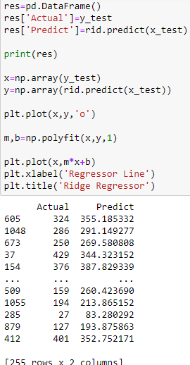
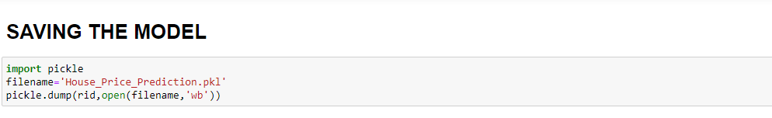
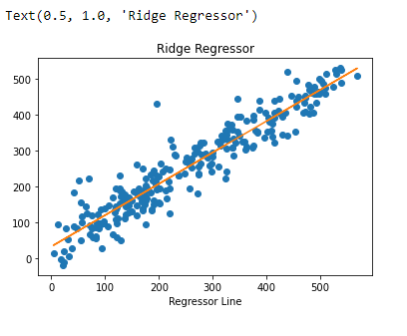
FINALIZE THE MODEL
After we analyze the model the Ridge Model gives us the better result when comparing mean absolute error, mean squared error ,R2_score and cross validation.
We further proceed to test the object then we have to save the model using pickle, and create a data frame of predicted values.

Slide 18
CONCLUSION
We make a machine learning model in order to improve the selection of place and decide price.
Our Visualization technique also helps to decide how price can change with particular feature.
The client wants some predictions that could help them in further selection of price strategies and our ML model helps them to do same with more effectively.

Slide 19


